Slide 1

Automation in farming using Zig-bee Technology
ELECTRONICS AND TELECOMMUNICATION DEPARTMENT
Submitted by:-
MOSAM BHIWAPURKAR
NIKHIL KOREKAR
RAHUL UBALE
HITESH UPARE
ANKITA WANJARI
Prof. Mrs. L. H. Gawali
(Head Of Department)
Electronics & Telecommunication
Prof. Mr. T. Pardhi
(Guide)
Electronics & Telecommunication
B.C.Y.R.C’S UMRER COLLEGE OF ENGINEERING, UMRER

Slide 2

INTRODUCING
Automation in farming using Zig-bee Technology

Slide 3
INTRODUCTION
The project is based on calculating the soil moisture contents and detecting the real time weather condition like temperature, humidity etc. and send it to the farmer using zig-bee communication which will be displayed in the LCD screen and according to temperature conditions the motor present at farm gets operated and hence the moisture present in the soil can be maintained automatically.

Slide 4
Components Required:-
Microcontroller
Zig-bee module
Amplifier IC
Temperature Sensor
Humidity sensor
LCD display
Relay
Other Supporting accessories

Slide 5

Block Diagram:-
Modules Present for Detecting the Weather Condition
Humidity sensor
Temperature sensor (LM35)
Microcontroller
ATMega32
Zigbee Module
LCD Display
(16 X 2)

Slide 6
Farmer Zone
Zig-bee Module
Microcontroller
LCD Display
(16 x 2)
Here the receiver module will detect the digital signal sent from the farm field and will be decoded by the microcontroller. The microcontroller attached with the display unit shows display on the LCD Screen. The display is 16x2 HD4478U display which has the capacity to display 32 characters at a time.

Slide 7
Humidity Sensor
Humidity Sensor
Microcontroller
Amplifier IC
Motor
This module will be attached at the farming zone, where humidity sensor will detect the moisture content of the soil, and send it to the microcontroller for its decision and control. If the moisture content in the soil is less, then controller will send a digital signal to turn on the water pump in the field.

Slide 8
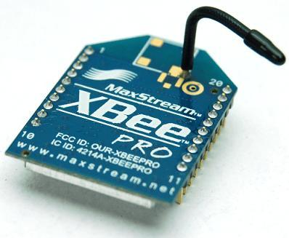
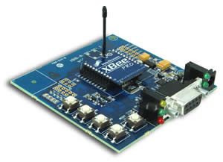
Zig-Bee Module

Slide 9
Why using Zig-Bee?
Wireless personal area network (WPAM).
Secure communication.
No line of sight required.
Low cost, low power & mesh forming capability.
Easy interface with microcontroller.
Good data transfer rate & bandwidth.

Slide 10
ATMega 32
The ATmega32 is a low-power CMOS 8-bit microcontroller based
on the AVR enhanced RISC Architecture . The AVR core combines
a rich instruction set with 32 general purpose working registers.
All the 32 registers are directly connected to the Arithmetic Logic
Unit (ALU) for fast processing of data, allowing two independent
registers to be accessed in one single instruction executed in one
clock cycle.

Slide 11
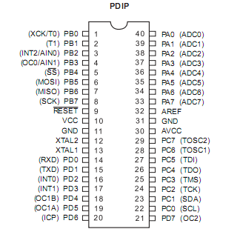
PIN DIAGRAM OF ATMega 32

Slide 12
Features of AVR ATmega32 Micro-controller
High-performance, low power AVR 8-bit microcontroller.
Advanced RISC Architecture.
Non-volatile Program and Data Memories.
32 Programmable I/O Lines i.e. four 8-bit Ports.
Speed upto 16 MHz.
In-built analog to digital converter.

Slide 13
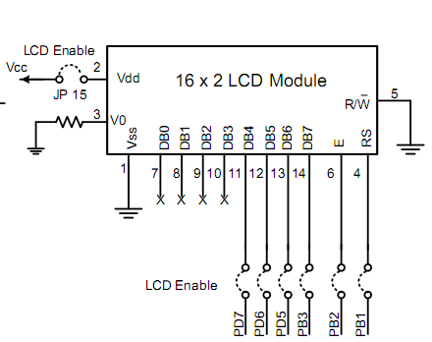
LCD DISPLAY HD44780U

Slide 14
Features of LCD HD44780U
16 x 2 dot matrix possible.
Low power operation support 2.7 to 5.5V.
4-bit or 8-bit MPU interface enabled.
Automatic reset circuit that initializes the controller / driver after power on.
Internal oscillator with external resistors.
Wide range of instruction functions

Slide 15
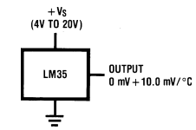
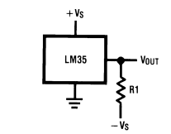
LM35 Precision Centigrade Temperature Sensors

Slide 16
Features of LM35 temperature sensor
Calibrated directly in °Celsius (Centigrade)
Linear + 10.0 mV/°C scale factor
0.5°C accuracy guaranteed (at +25°C)
Rated for full −55°C to +150°C range
Suitable for remote applications
Operates from 4 to 30 volts
Less than 60 µA current drain
Low self-heating, 0.08°C in still air
Nonlinearity only ±1⁄4°C typical

Slide 17
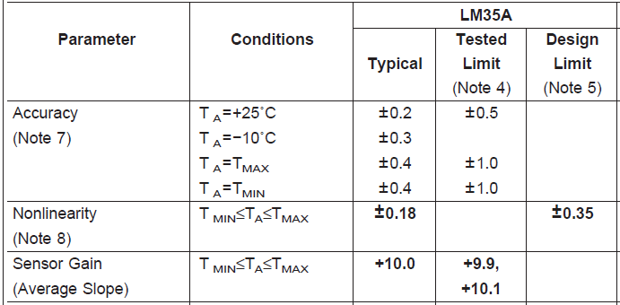
Temperature sensor (LM35) datasheet

Slide 18
Conversion of sensor data into voltage
When the microcontroller ATMega32 gets the reference voltage at AREF pin then the microcontroller combines the output of the temperature sensor with the reference voltage to increase the sensitivity of the microcontroller.
Example:- If the AREF pin gets an input of 5V and the sensor gives 10mV when the temperature rises by 1ºC, then the microcontroller makes the calculation as 5.01V i.e. (5V+10mV).

Slide 19
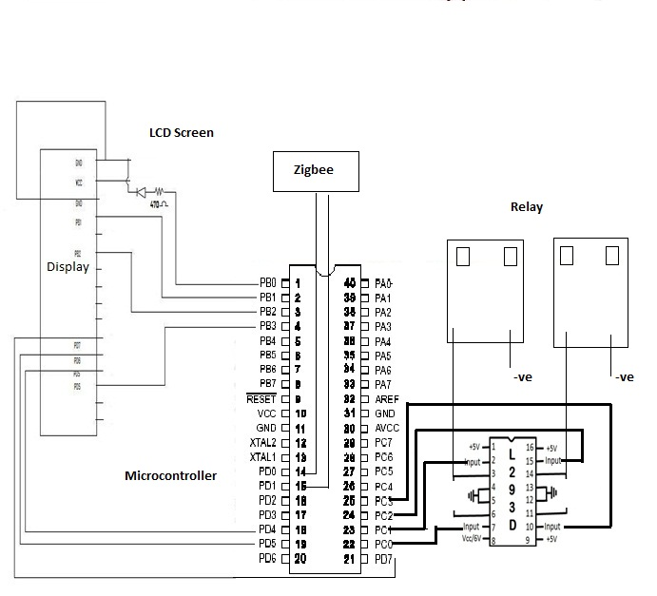
Transmitter Section

Slide 20
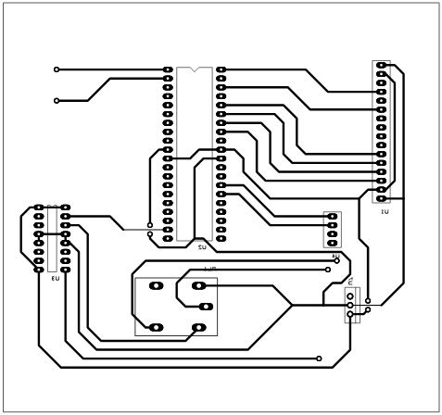
Transmitter Artwork

Slide 21
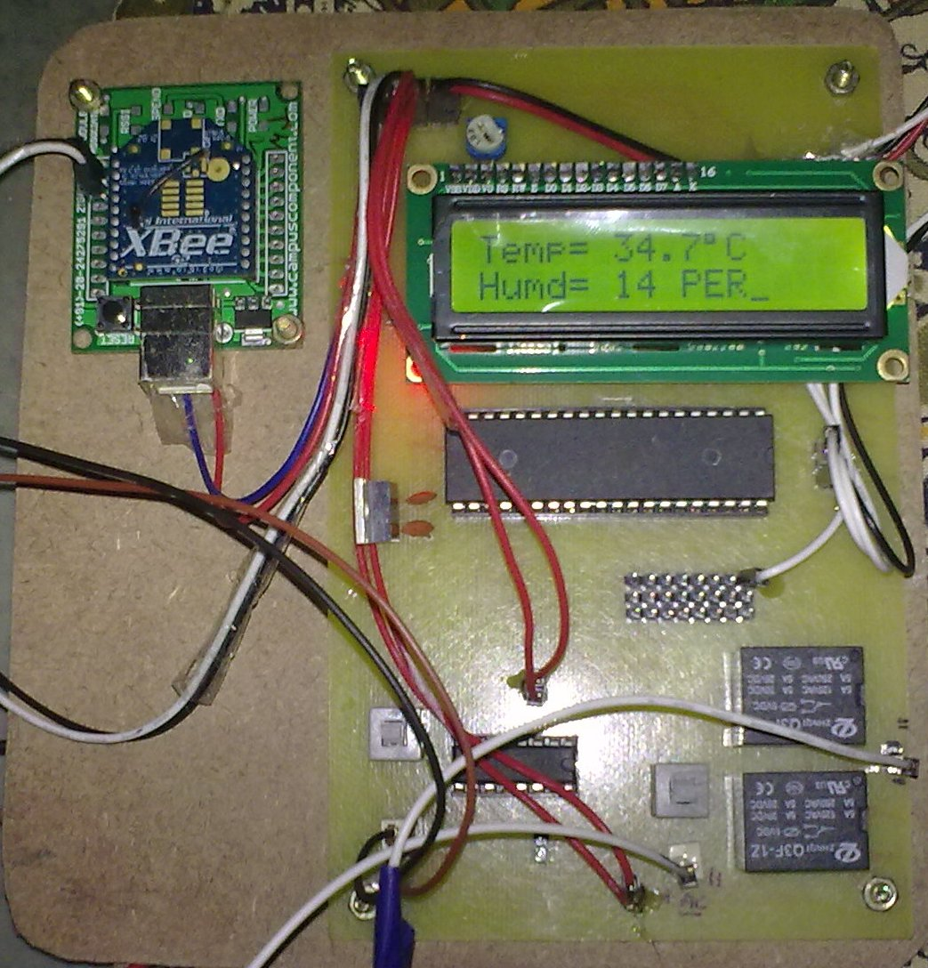
Transmitter PCB

Slide 22
Flow-chart of transmitter section

Slide 23
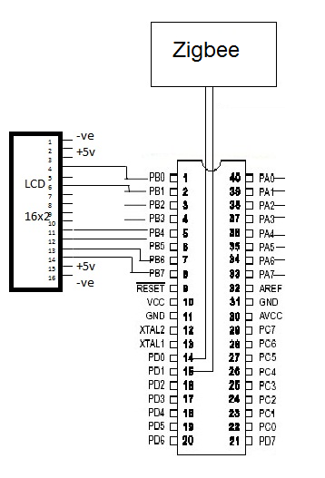
Receiver Section

Slide 24
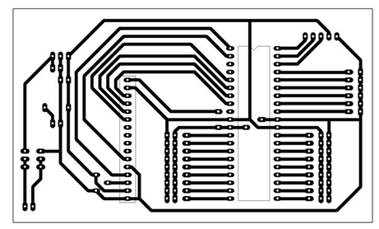
Receiver Artwork

Slide 25
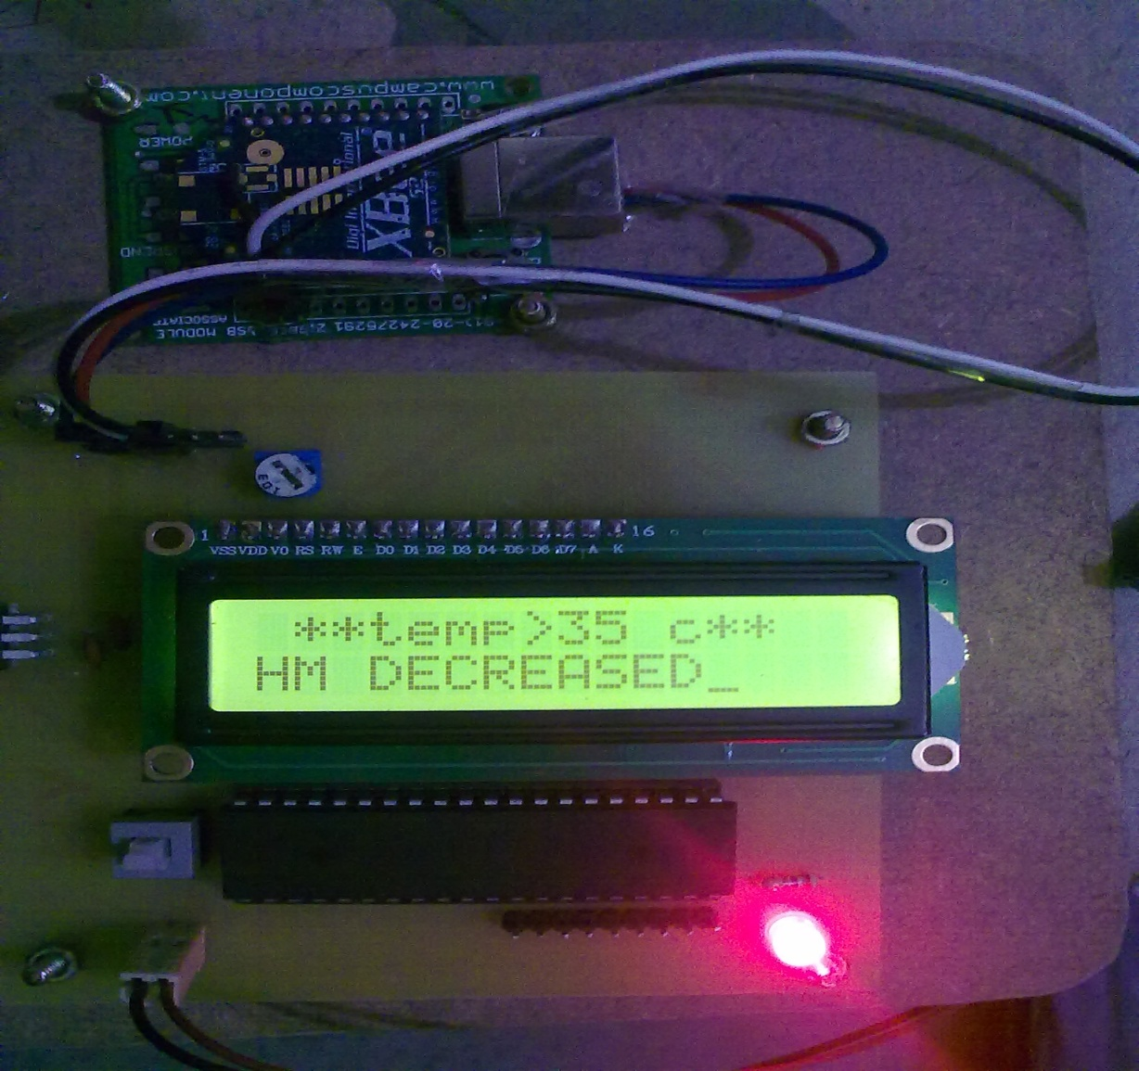
Receiver's PCB

Slide 26
Flow-chart of receiver section

Slide 27
Advantages of the project
It is economical as compared other technology.
Single Device can communicate with the other distant located devices.
It is working on precision value of temperature.
Fast response due to ATmega32 microcontroller.
Required less human effort.

Slide 28
CONCLUSION
Embedded system for automatic irrigation of a farm field offers a potential solution to support site-specific irrigation management that allows producers to maximize their productivity while saving the water.
This project is designed using microcontroller.
The temperature and humidity sensors detect the field temperature and field humidity, the moisture sensor detects the soil moisture and then the sensor values are sent to the farmer zone.
The microcontroller checks the conditions for irrigation and performs automatic irrigation.
Field conditions were site-specifically monitored by in-field sensor stations distributed across the farm field, based on high, low, sloppy and flat areas.
This irrigation system updates motor status automatically according to the maximum and minimum values of temperature, humidity and moisture in the control system for a proper irrigation.
Field system are wirelessly communicates with a farmer zone by Zig-bee technology.
The modules operate within the 2.4 GHz frequency band and outdoor RF line-of-sight range up to 4000 ft. (1200 m) with RF data rate of 250,000 bps.

Slide 29
Applications of project
This technology is applicable to detect the real time environmental condition.
It is useful for farmers, go downs or mass storage places, power plants etc.
This system can also be used in industrial applications where temperature sensing is required.
It can be also used to preserve pharmaceutical and drugs which are used for medical purpose.
This system is best for green-house farming.
System is also applicable to maintain the temperature in aquariums.

Slide 30
FUTURE SCOPE
Smart field monitoring by wireless nano technology.
Soilnet – a zig-bee based soil moisture network to cover a bigger farm field.
SIM300 can be used as a future communication system for the project which will send direct information to the farmer on his phone.

Slide 31
THANK YOU

